Slide 1
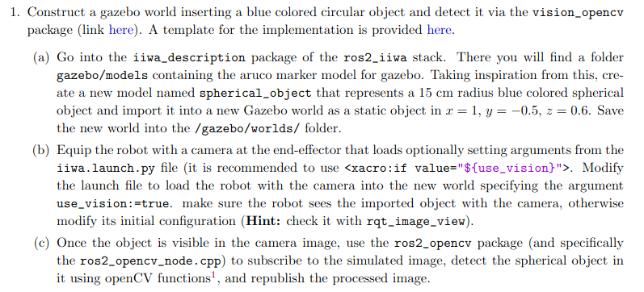
Homework 3
This homework consist in using again the iiwa manipulator but in this case we’re supposed to use some more advanced vision tasks, a part from just mounting a camera on the robot. The first point of this HW is showed below and in the next slides I’ll discuss about it and show the results I’ve obtained:

Slide 2
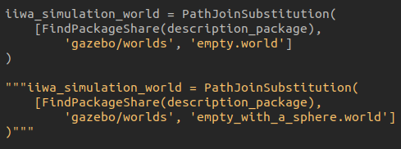
Homework 3
In this homework you’ll need to pass from the world containing the blue sphere to the one with the aruco tag, I wanted to implement it in a dynamic way with a parameter but unfortunately I don’t have so much time to do it, to simplify you something I added this code in the iiwa.launch.py:
So when you want to pass from a gazebo world to anothe comment one of this and uncomment the other ;)

Slide 3
Homework 3
So, firstly we have to create a new model of a blue spherical object, more in detail a static one so it not would fall and then we have to import it our gazebo environment. Then we have to mount a camera on the robot but only if the parameter “use_vision” is set to true and we need to test this. For last we need to use and modify appropriately the openCV node, so that this software can see what the camera sees and its task is to identify the blue sphere in our world. So in the next slides I’ll show what I’ve done to implement this and also all the tests to prove it.

Slide 4
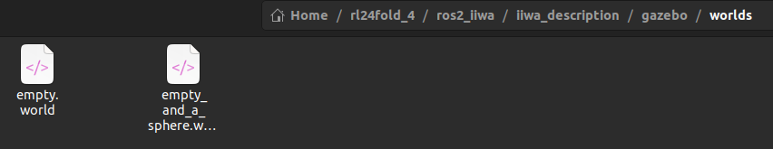
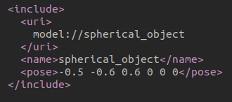
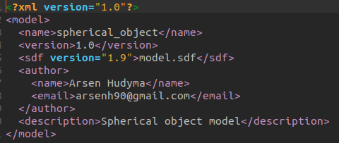
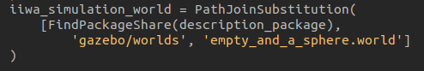
Homework 3
Here there are pretty much photos but lets proceed in order. One of the first things that I did was to create a new world file with a name that is autoexplicative. In this world I included the model of the sphere, specifing the path to it and the folder name. In this folder there is a config file which is used to give a description to the model and also other informations such as the authot of it. More importantly, there’s specified the sdf file from which we can retrieve the effective model (showed in the next slide). The last photo in the lower right side is some code of the launch file, so that we can decide in which world the robot has to spawn.

Slide 5
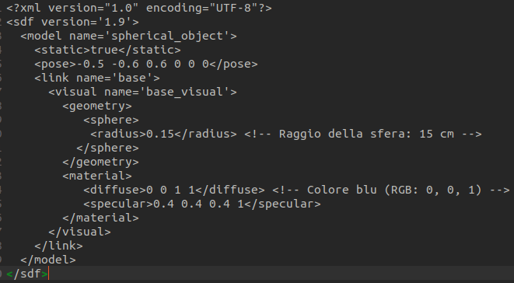
Homework 3
Like said before, here there’s the sdf file of the sphere, the configuration static = true is important, otherwise the sphere would fall due to gravity:

Slide 6
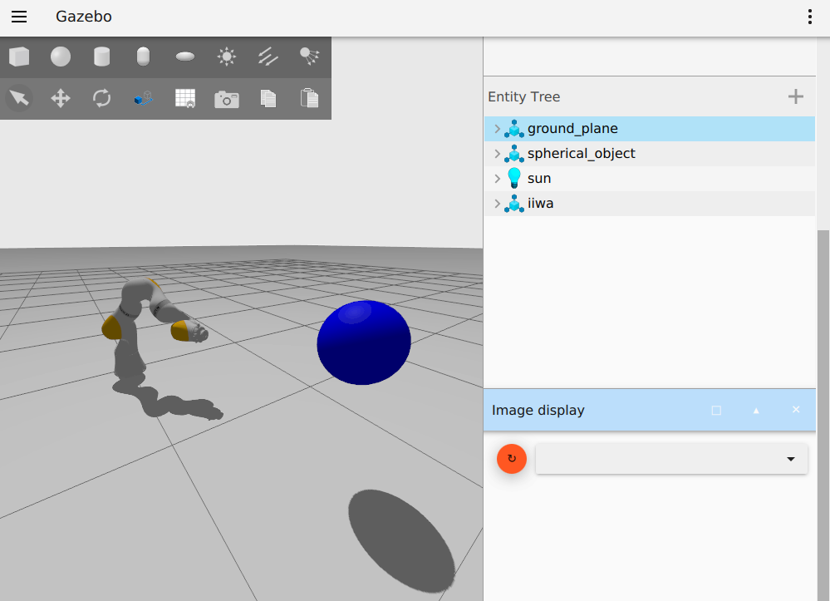
Homework 3
Here we can see that the blue sphere is present in our world and also another thing that we can notice is that the camera isn’t mounted, in fact we don’t see anything in the image_display and there are no topics, that’s because the use_vision parameter is set to false by default:

Slide 7
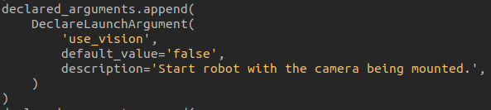
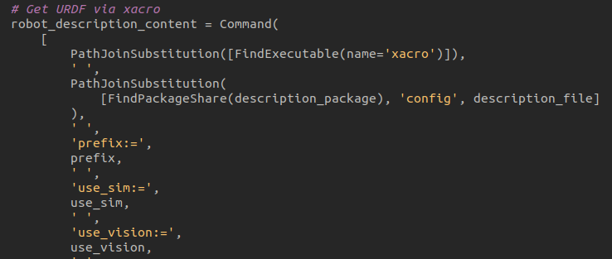
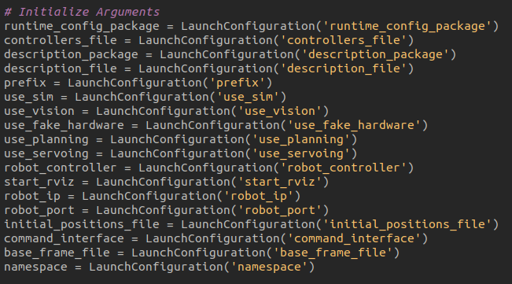
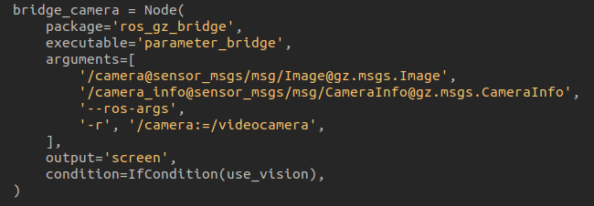
Homework 3

Slide 8
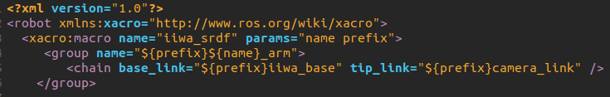
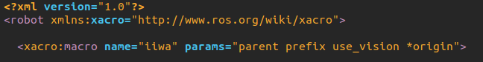
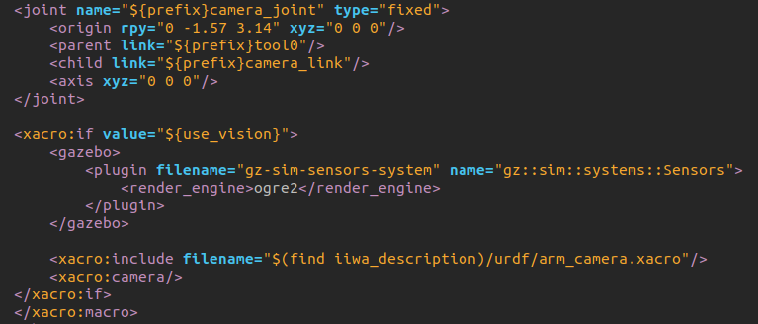
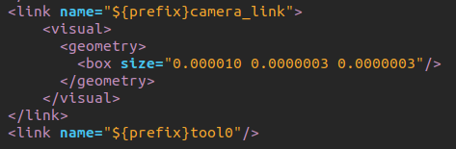
Homework 3
Here instead it’s shown how the camera is implemented in the description file of the robot, we can notice that also in this code we use the “use_vision” parameter to load the camera. The camera link and the camera joint are still here even if we don’t use the camera but effectively it activates only when we want.

Slide 9
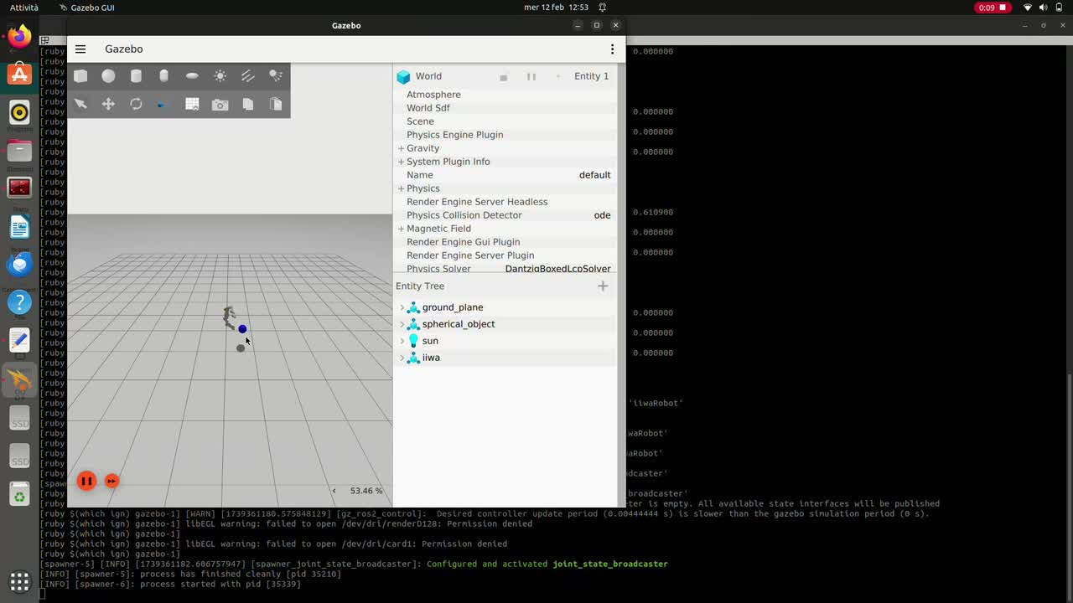

Slide 10
Homework 3
And then we have the last task for this first point. We have to write some code using the openCV functionatilies, this code has to subscribe to the topic on which the camera publishes the frames data and then the node needs to elaborate this data and try to detect some sort of element, in this case a blue element and we can find a way to use this information but also the element is a sphere so in 2D is similar to a circle, and we can use this information too as well. Here I show the code of the ros2_opencv_node and then I’ll show the results with a video.

Slide 11
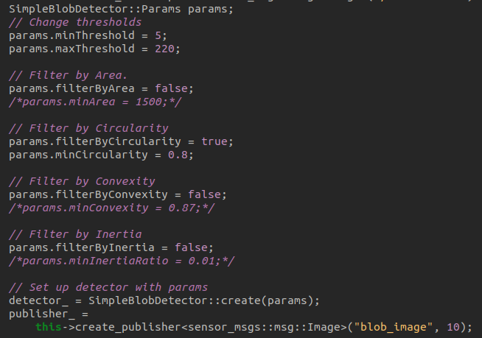
Homework 3
The first thing that I’ve done was to create a subscription to the camera topic so that the blob detector can see what the camera sees:
Then I declare the SimpleBlobDetector (it detects this so classe blobs) and I set and modify some useful parameters. Like the Threshold for the color palette but it isn’t so necessary, more useful is the filter by circulrity, so I set it (not like 1 so a perfect circle but some less, so that the little distortion of the camera does not affect the detection.

Slide 12
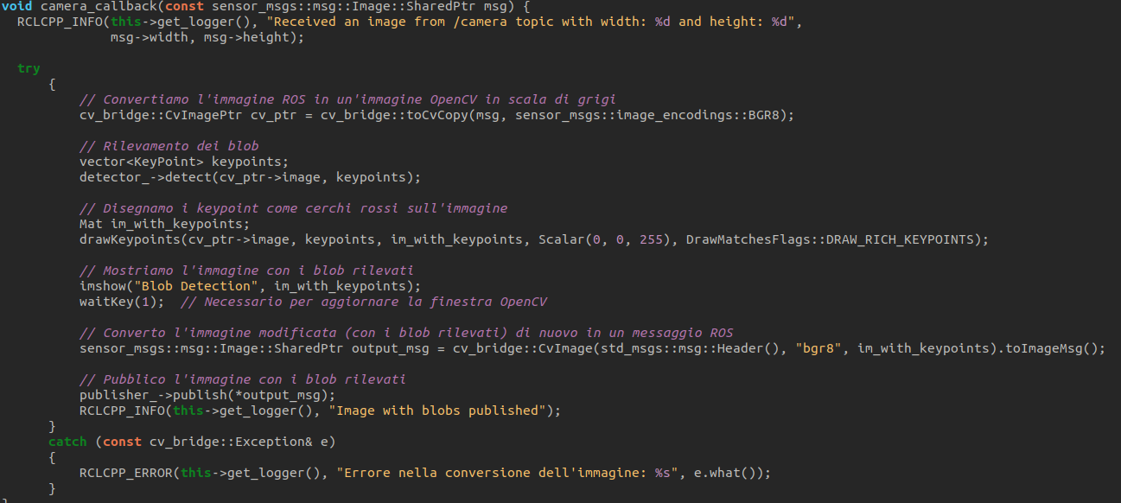
Homework 3
I’ve also implemented a publisher to publish the relevated image, if the object is detected it appears surrounded by a red circle. How I done this is shown below:

Slide 13
Homework 3
After all this slides and words, we only need a video that shows the detection of our proces and how we can understand that it works! And it’s shown in the next slide:

Slide 14
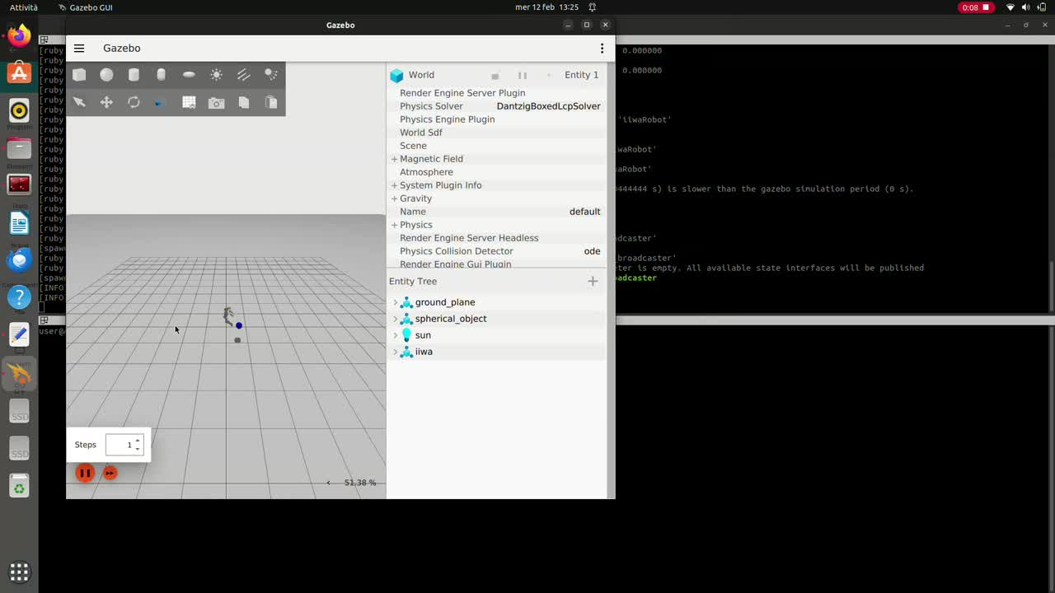

Slide 15
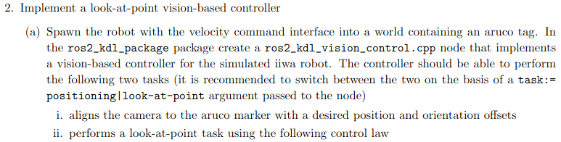
Homework 3
So for now the first point of this HW is done, now is the turn of the second and last point, here are shown the tasks that we need to implement:
So, for this case we need to use the world with the aruco tag now and before the implementation of the control part one thing is clair, we need to be able to see the aruco tag and also to retrieve the TF data related to the tag, so the first thing to implement is this.

Slide 16
Homework 3
Fortunately for us we already ha some code to do this function, in particular the ros2_vision, usb_cam and aruco_ros packages. So in the next slides I’ll show a video in which you’ll see that I start mainly an aruco ros2 simple node, that in base of the data retrieved from the camera topic, “looks” if in the image there’s the aruco marker n° 201, if it is so the node will publish some tf data on the hononymous topic. This data represents the Transformation matrix between the robots camera and the aruco tag. But we’ll see all that we need in the next slide:

Slide 17
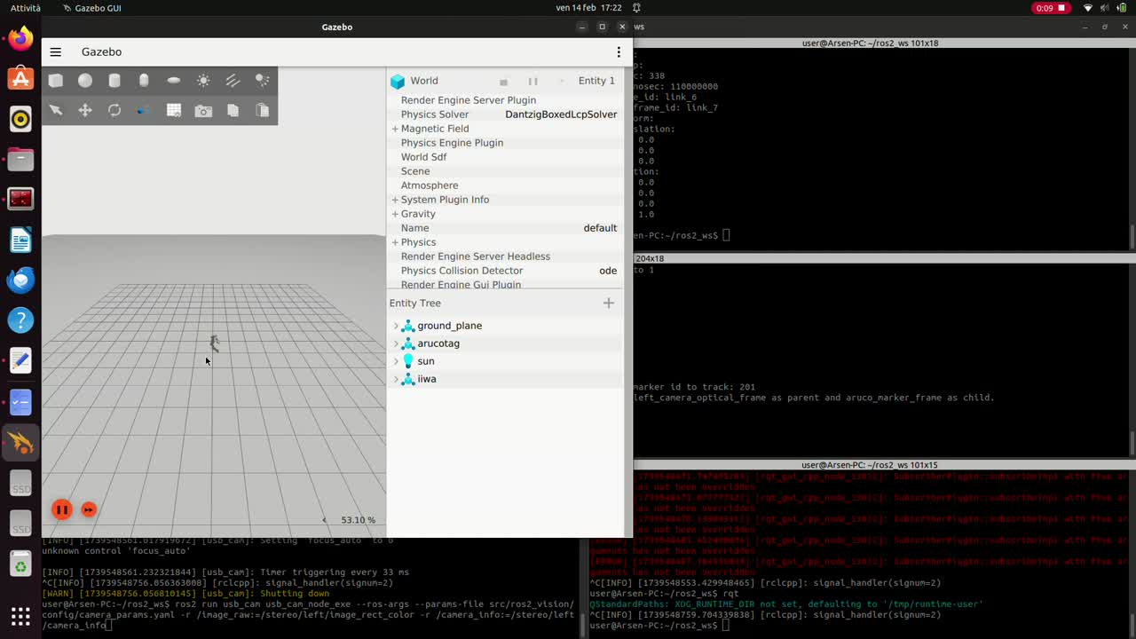

Slide 18
Homework 3
Now that we’re sure that we are receiving data in the TF topic and also that the TF’s change once we translate or rotate the aruco tag, we can talk about the first control task, so the positioning one.
And a funny thing that pops out is shown in the next slide. After I tried to implement the positioning task in the ros2_kdl_vision node, I tried again to run the simulation with the exact commands that I’ve run in the previous simulation, and the result is that I don’t have any results out of the aruco node...
So in the next slide I’ll put the video to show this and then at least I’ll show how I tought about the definition of the vision node and I’ll show the developed code.

Slide 19
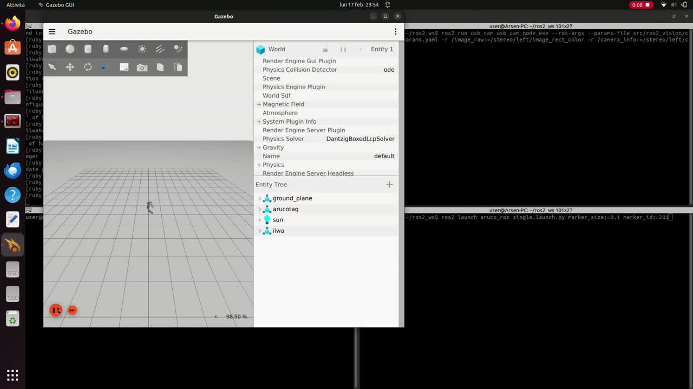

Slide 20
Homework 3
So now we’ll talk about the positioning task, it’s basically the simplest one and I believe that it consist in subscribing to the aruco_single/pose topic, retrieve the topic data and so the position and orientacion displacement between the camera frame and the aruco tag one. After that, in a dynamic way, we’ll be chossing an end position for our end effector based on the position of the aruco tag but with some offset, for example in only one dimension. And we can also add an orientation offset, also in this case defined in a dynamic way based on the orientation data from the aruco tag (in this case quaternions are used).
But lets proceed in order, the task asks us to use velocity command interface, so in this case it isn’t so useful to have the cmd_interface parameter, but I decided to use anyways this parameter because it could be useful later, for default it’s set to velocity.
Then we need the task parameter, by whitch we specify which one of the 2 tasks we want to use, the positioning one or the look at point, the code to do this is shown after this slide:

Slide 21
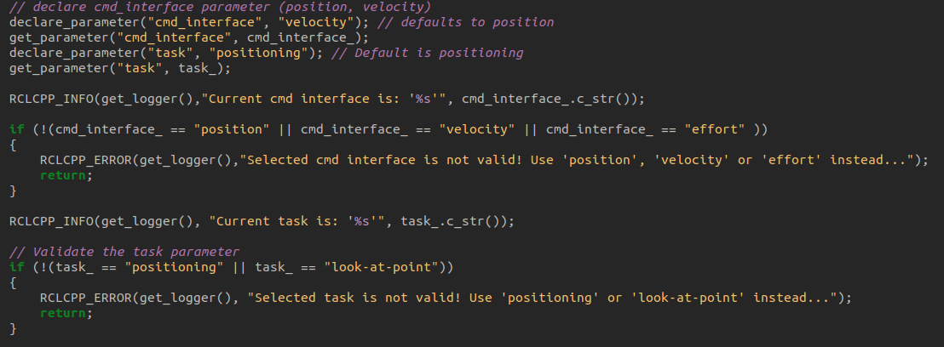
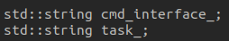
Homework 3
We can also see the declaration of this parameters in the smaller image.

Slide 22
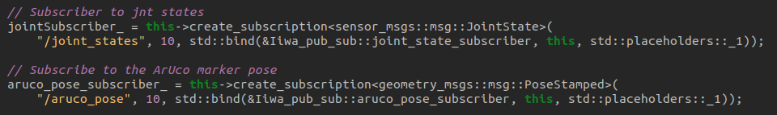
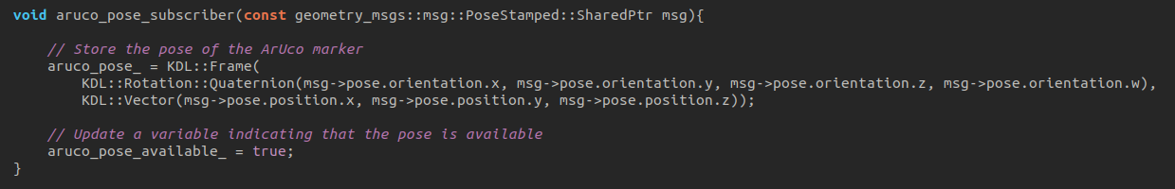
Homework 3
In this case we don’t need only to subscribe to the joint state topic but also to the aruco pose publisher (if it would work), so here are the commands to do so:
We can see that we retrieve the aruco pose data in an aruco_pose variable, which contains the quaternion and the position data.

Slide 23
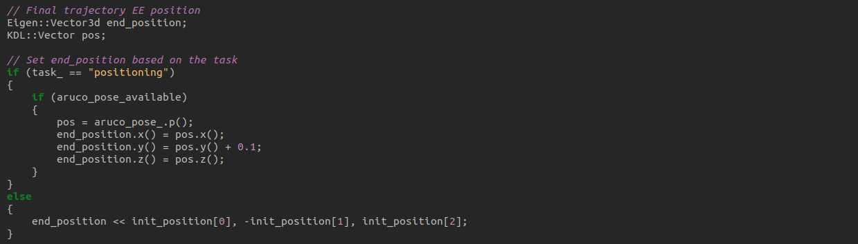
Homework 3
Another important part of code, is the one that I use to set in a dynamic way the EE final position, based on the position displacement between the camera and the tag, adding an offset:

Slide 24
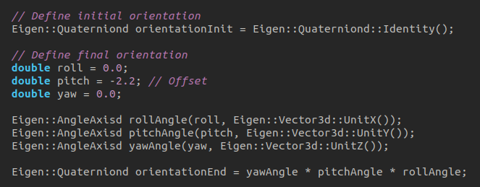
Homework 3
For the orientation displacement, for now it isn’t so dynamic because its not based on the aruco quaternion information, I think that it wouldn’t be hard to implement, but however I can’t test it and see what happens, so here is the first simple implementation:

Slide 25
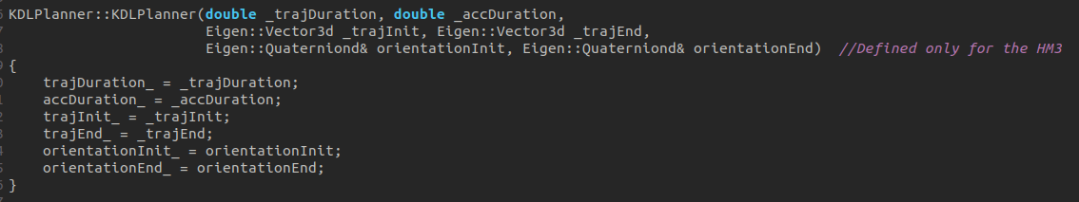
Homework 3
Then I use the planner to compute the trajectory, and for this first implementation I decided to use it in a simpler way, like the one that we already had when we had given the ros2_kdl_package, so without using nor linear or circular motion, and only defining a trapezoidal velocity profile, based on the initial and final position. For the orientation part, I used a function which interpolates the initial quaternion and the final one, in function of the time, so that when the time goes from zero to the time for the end of the trajectory, the quaternion will step by step passing from the initial one to the final. The code to do so in showed below, obviously I changed also the KDLPlanner.h file ;)

Slide 26
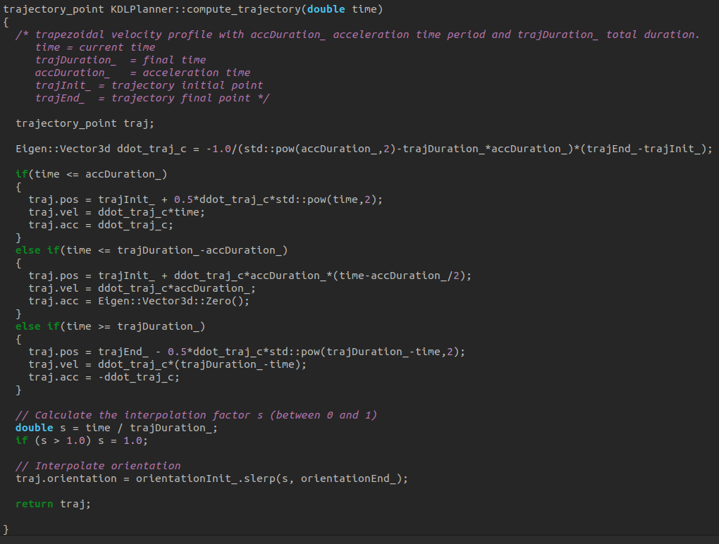

Slide 27
Homework 3
Then basically the code is the same as the ros2_kdl_node used for the HM2, little changes are done because we use just a simple trapezoidal velocity profile, without specifing a certain trajectory. So there are some simplified parts of code just for the first version try.
As always thanks for the attention, but before pass to the discussion of the next HW I’ll write the launch commands for this simulation (for the usb cam package I use a slightly different command so use the one that works for you).
The launch of the iiwa is basically the same but we need to use the vision parameter, so:
ros2 launch iiwa_bringup iiwa.launch.py use_sim:=true use_vision:=true
Then for the usb cam launch and the aruco simple launch:
ros2 run usb_cam usb_cam_node_exe --ros-args --params-file src/ros2_vision/config/camera_params.yaml -r /image_raw:=/stereo/left/image_rect_color -r /camera_info:=/stereo/left/camera_info
ros2 launch aruco_ros single.launch.py marker_size:=0.1 marker_id:=201
And if it works, you can try the vision node typing:
ros2 run ros2_kdl_package ros2_kdl_vision

